Slide 1
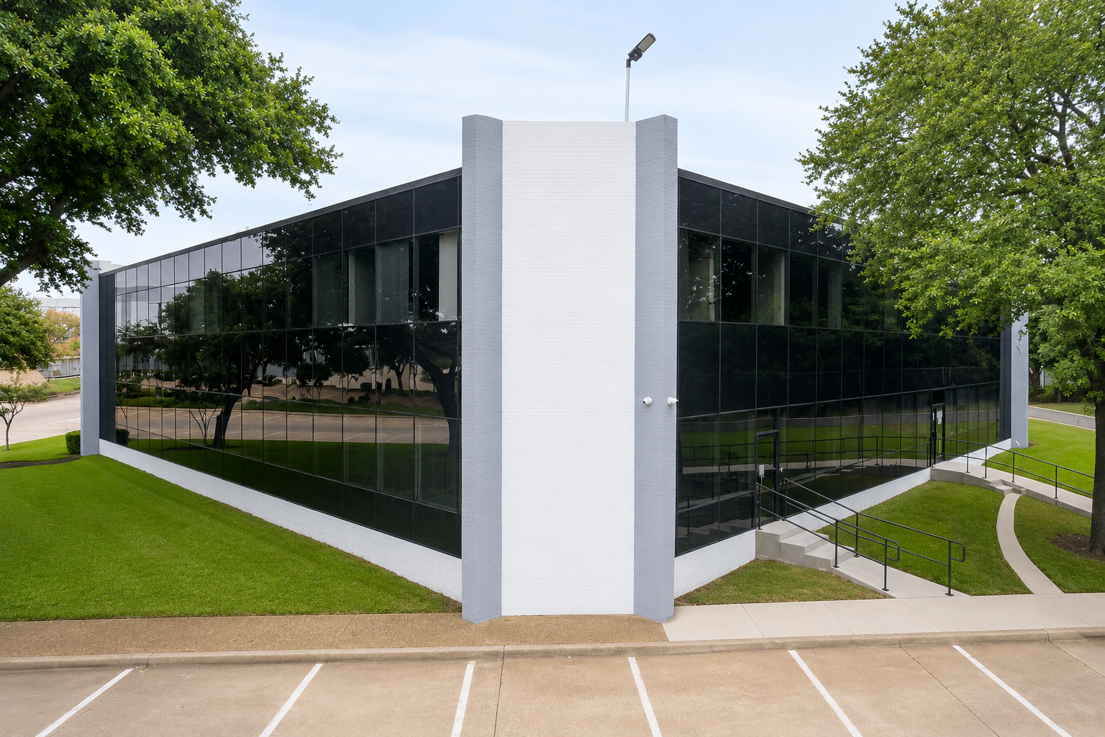
FOR LEASE
BELT LINE
OFFICE PARK
4320–4324 N. Belt Line Road
Irving, Texas 75038
$18 – $22
PER SF / YEAR · FULL SERVICE + E
· Office Leasing
WELLS ASSET MANAGEMENT, INC.

Slide 2
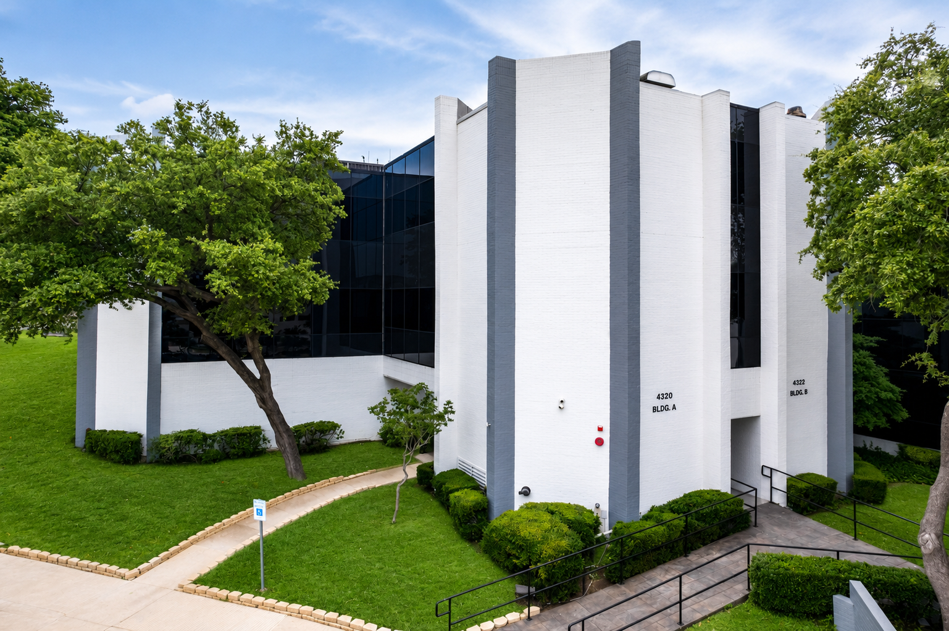
PROPERTY OVERVIEW
Belt Line Office Park is a three-building, 63,558 SF Class B office campus under new ownership, minutes from DFW International Airport in prestigious Las Colinas. Ownership is investing significant capital in superior interior renovations and will deliver custom finish-out to qualified tenants — perfect post-pandemic buildings with easy drive-up daily access.
Property Type
Office — Traditional
Total Building SF
63,558 SF
Available Suites
417 – 3,371 SF
Lease Rate
$18 – $22 / SF / YR
Lease Type
Full Service + E
Buildings A & B — repainted exteriors with reflective glass curtain walls and mature shade trees throughout the campus.
Parking
3.5 / 1,000 SF
Tenancy / Class
Multi-Tenant · Class B
Quick access to Hwy 114, 121, 183 & President George Bush Turnpike

Slide 3
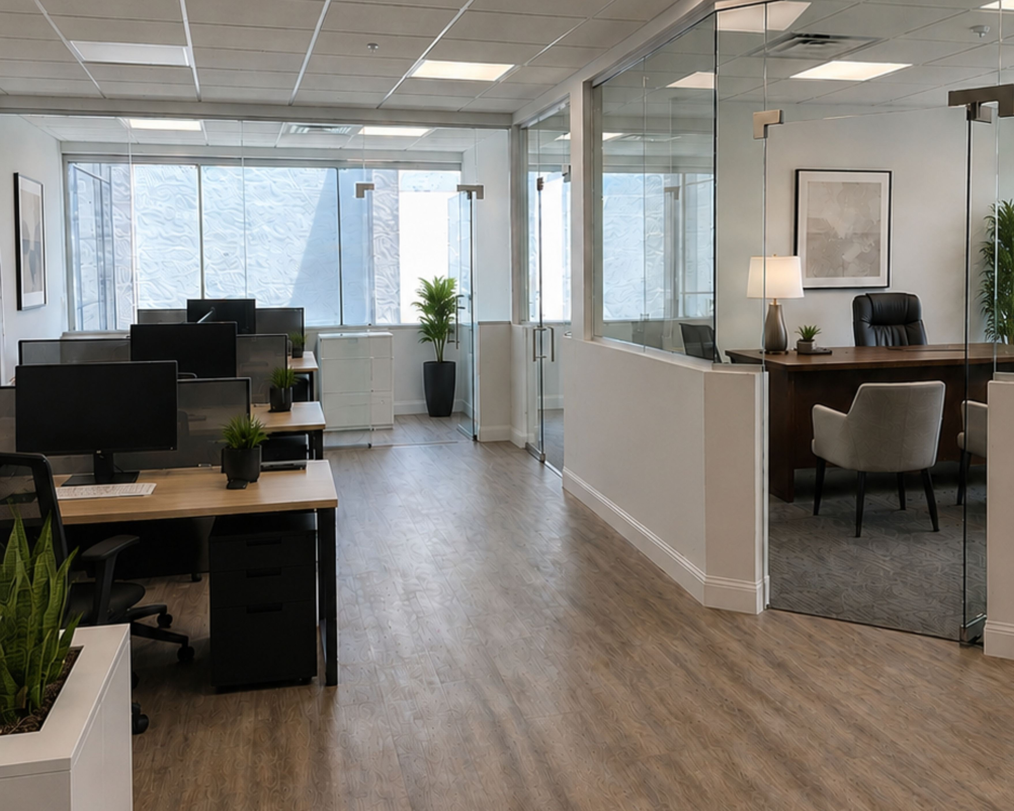


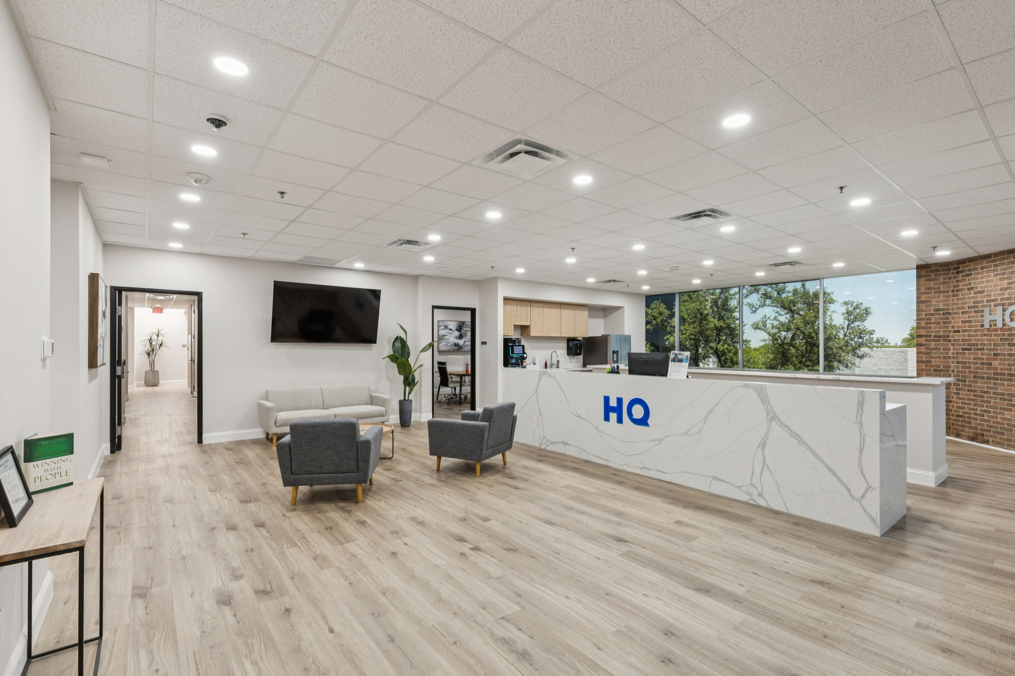



FRESHLY REMODELED.
MOVE-IN READY.
New ownership is deploying significant capex across the park. The remodeled second-floor suites in Building B set the standard for what's coming.
New Finishes Throughout
Updated LVP and carpet flooring with modern glass office fronts that carry natural light deep into each suite.
HQ-Regus Facility on Site
Day office rentals, meeting and conference room bookings, and mail services — right inside the building.
Tenant Lounge & Kitchen
Bright, inviting kitchen and lounge areas enhance tenant comfort and convenience throughout the workday.
Custom Tenant Improvement
Bring your vision. Ownership will build a TI package designed around the way your team works.
Elevator-Served Access
Easy drive-up daily access with elevator service and substantial 3.5 / 1,000 SF parking.

Slide 4
AVAILABLE SUITES
All suites offered Full Service with negotiable lease terms · Direct listings
SUITE | RENTABLE SF | RATE | CONDITION
B101 | 1,852 SF | $18.00 / SF / YR | Customizable — TI package available
B113 | 417 SF | $18.00 / SF / YR | Customizable — TI package available
B114 | 1,933 SF | $18.00 / SF / YR | Customizable — TI package available
B201 | 2,888 SF | $18 – $22 / SF / YR | Freshly remodeled — glass fronts, new LVT
B202 | 1,765 SF | $18 – $22 / SF / YR | Freshly remodeled — glass fronts, new LVT
B203 | 2,766 SF | $18 – $22 / SF / YR | Freshly remodeled — glass fronts, new LVT
B204 | 3,371 SF | $18 – $22 / SF / YR | Freshly remodeled — glass fronts, new LVT
C105 | 2,644 SF | $18.00 / SF / YR | Customizable — TI package available
C201 | 1,071 SF | $18.00 / SF / YR | Customizable — TI package available
C206 | 1,789 – 2,577 SF | $18.00 / SF / YR | Divisible — combine with adjacent suite
C207 | 1,434 SF | $18.00 / SF / YR | Customizable — TI package available
C208 | 788 – 2,577 SF | $18.00 / SF / YR | Divisible — combine with adjacent suite

Slide 5
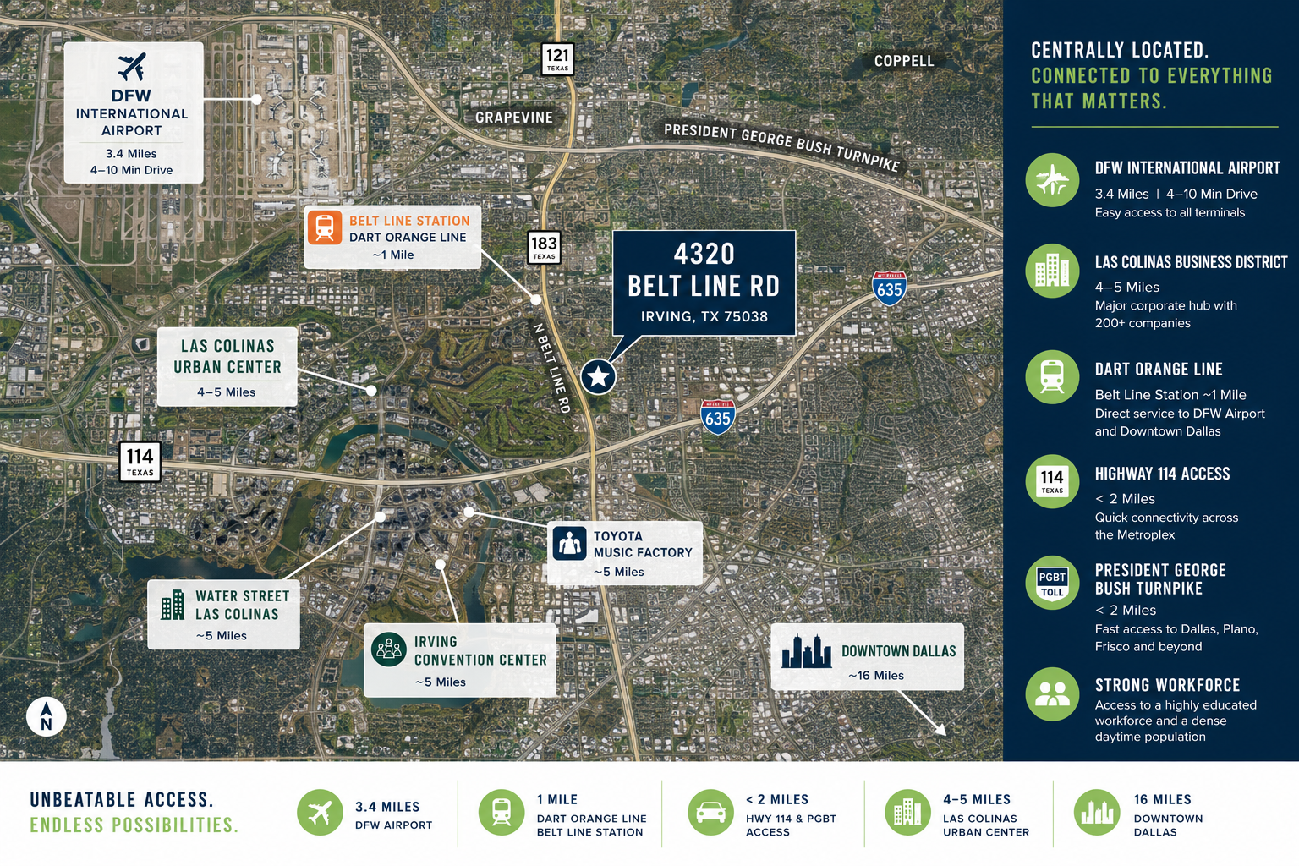





3.4 MI
DFW Airport
4–10 min drive
1 MI
DART Orange Line
Belt Line Station
< 2 MI
Hwy 114 &
PGB Turnpike
4–5 MI
Las Colinas
Urban Center
16 MI
Downtown
Dallas

Slide 6




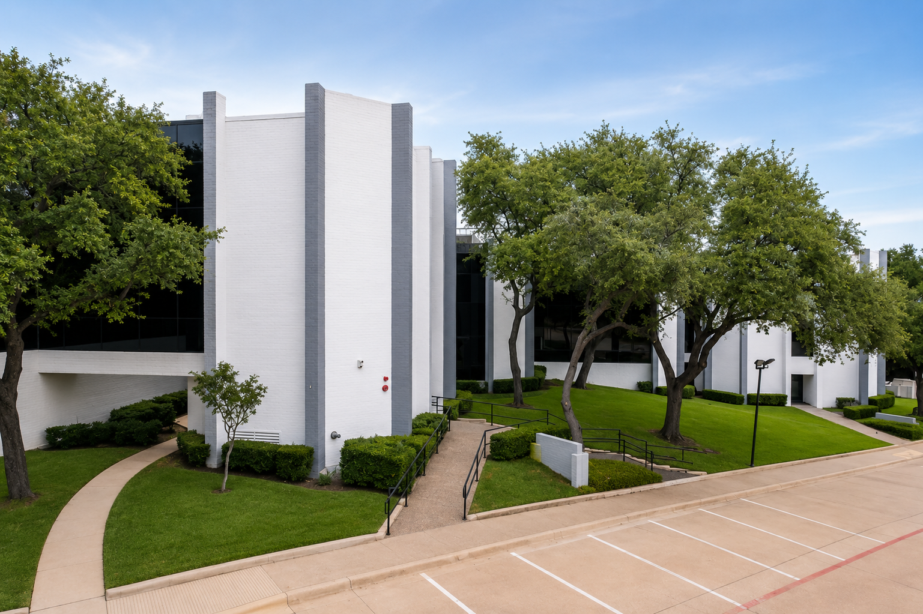
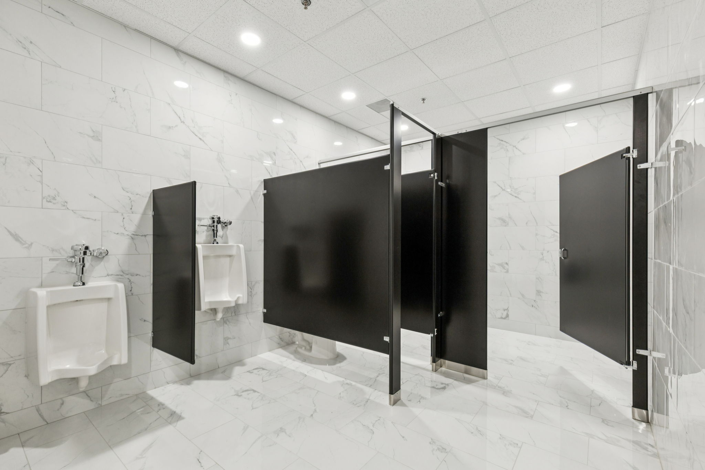
THE LAS COLINAS ADVANTAGE
A dense daytime population and highly educated workforce within one mile of the front door.
29.4K
22.4K
$68.2K
33
Population within 1 mile
Employees within 1 mile
Median household income
Median age
+7% vs. 2020
Management & professional led
$76K projected by 2029 (+11%)
Young, renter-dense trade area
A landscaped, park-like campus on N. Belt Line Road — surrounded by new multifamily, retail, and the Las Colinas corporate base.
Minimal flood & fire risk (First Street Factor 1/10)

Slide 7
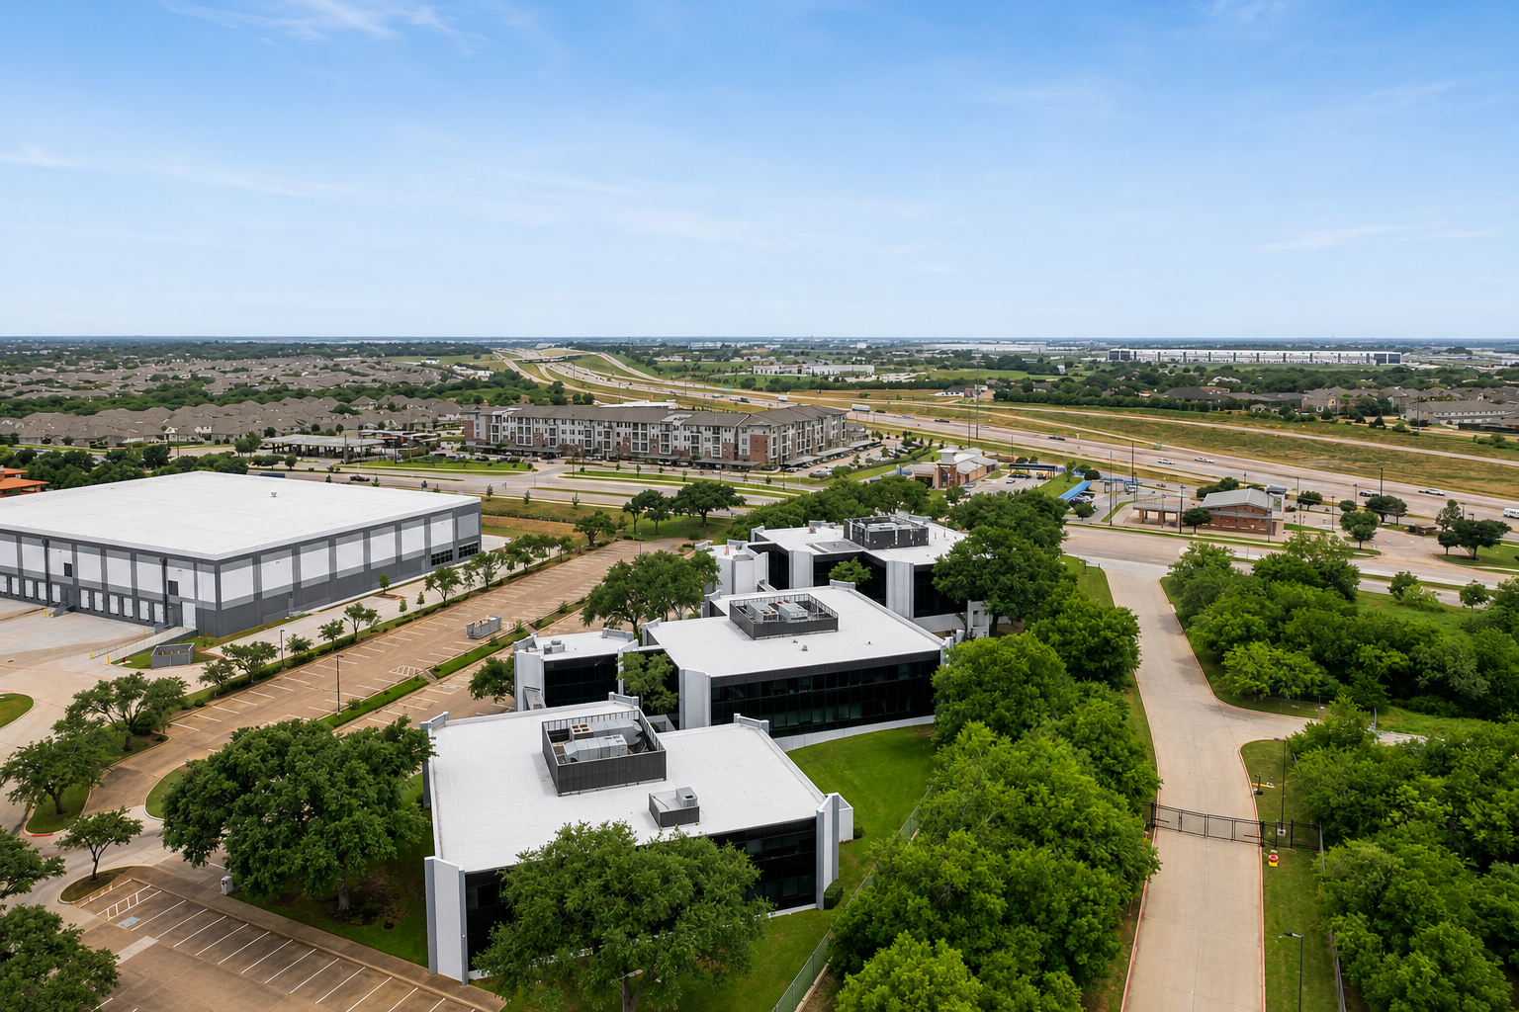

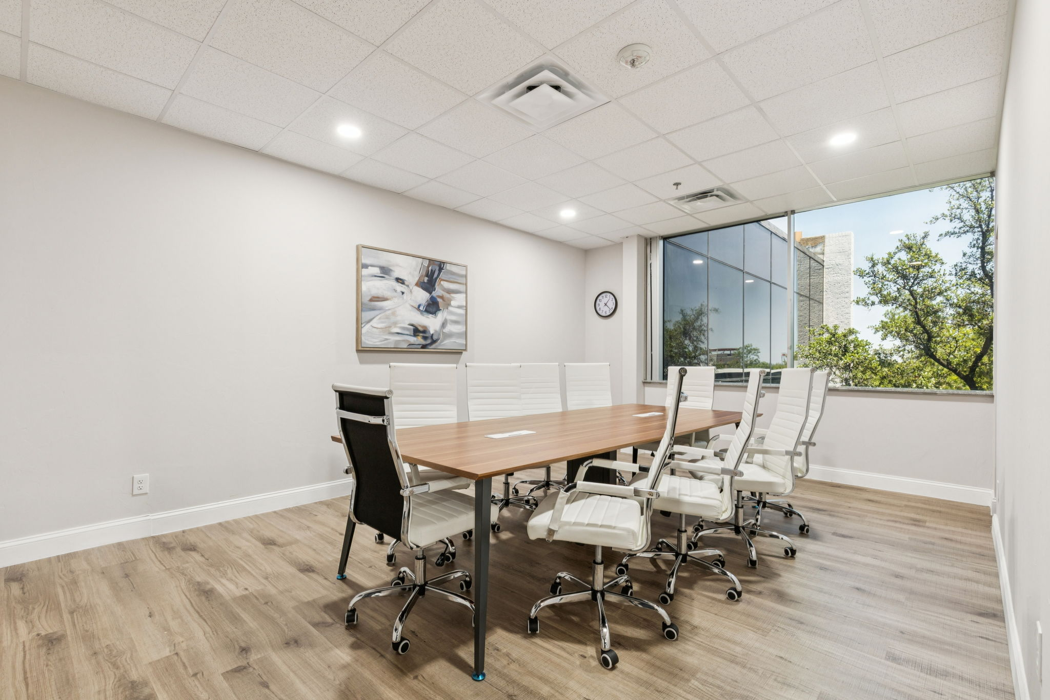


SCHEDULE A TOUR
Suites from 417 SF to 3,371 SF — combinable up to 10,500 SF of prime office space. Negotiable terms, Full Service rates, and ownership ready to build to suit.
Richard Buford
Commercial Leasing · TX License No. 0366104
972-754-3024
rbuford@wellsasset.com
Austin Wells, CPM®
VP of Commercial Investments · TX Lic. 0823411
214-802-6563
austin@wellsasset.com
4320–4324 N. Belt Line Road, Irving, TX 75038
WELLS ASSET MANAGEMENT, INC.

